Slide 1
E –commerce market basket analysis

Slide 2
Introduction
The primary goal of market basket analysis is to pinpoint the goods that consumers desire to buy. To do this, we must be aware of the customer's purchasing behavior. By doing so, we may propose items that are bought together and sets of products that are frequently purchased from the business by grasping the customer's behavioral patterns.
In this case study, we began by exploring, manipulating, and analyzing the data had been done and creating an invoice product matrix for the ARL data structure by choosing any country; in this case, we chose Germany. We then created German association rules and suggested a product to users at the basket stage.
Then, we build the model by implementing the RFR algorithm ,we built Regression model to identify the elements that have the greatest impact on the revenue that the company receives, after which we launch marketing initiatives to produce the largest profit.
Additionally, we conducted cohort analysis and RFM-Recency Frequency Monetary Analysis.

Slide 3
Expected Outcomes
Market basket analysis helps improve consumer happiness and sales. Retailers can adjust product positioning, provide special discounts, and develop new product bundles to promote future sales of certain combinations after using data to identify goods that are frequently bought together.
These upgrades can increase revenue for the store while also enhancing and adding value to the customer's shopping experience. Customers may have a higher attitude or sense of brand loyalty toward the business if market basket analysis is used.

Slide 4
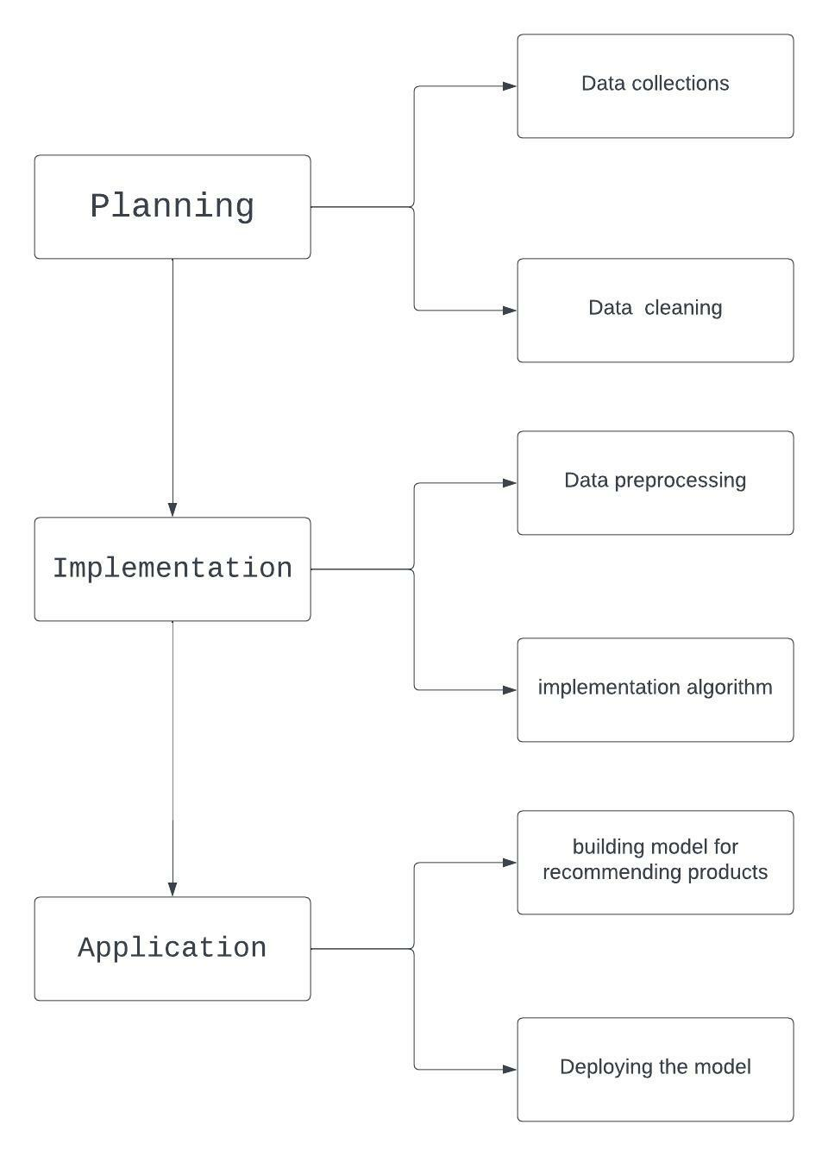
Architectural design

Slide 5
About dataset
This is a transnational data set which contains all the transactions occurring between December 1, 2010, and December 9, 2011.The company mainly sells unique all-occasion gifts. Many customers of the company are wholesalers
Data preparation, such as Look for repeated rows. Cleaning up the Description field to ensure correct aggregation, Within the invoice number If the code begins with the letter C, it indicates that the invoice has been cancelled, thus we must delete it as well as the outliers.
EDA- Exploratory data analysis is performed on data to get more understanding about the dataset, such as which nation generates far more revenue.
Using RFM analysis (Recency Frequency Monetary), we can determine how many best customers, loyal customers, Big Spenders, Almost Lost, Lost Customers, and Lost Cheap Customers each nation has.

Slide 6
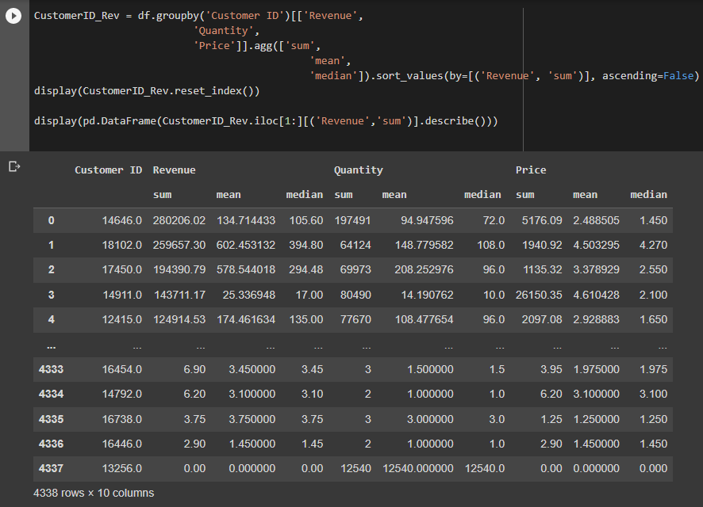
Code
Which, customerID, bring most revenue? And, which, customerID, buy most in term of quantity

Slide 7
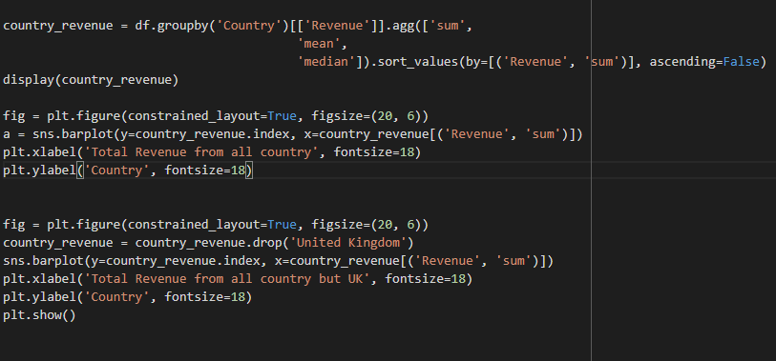
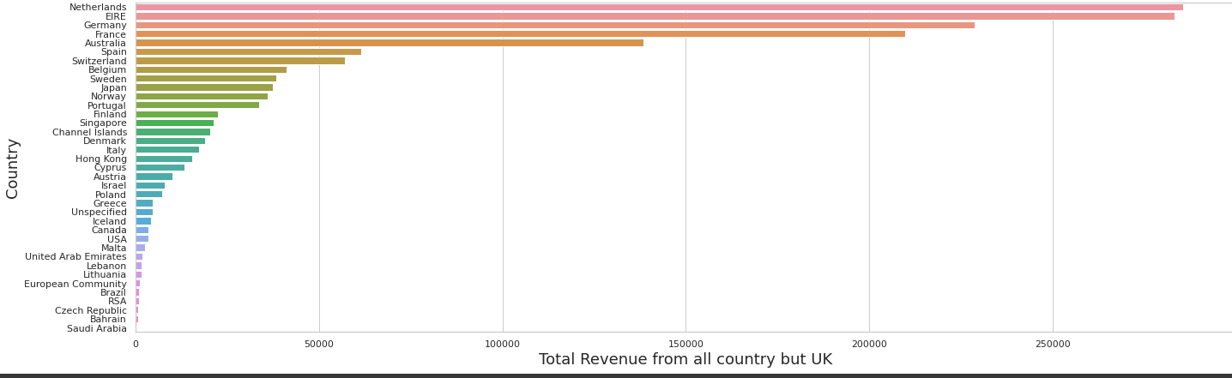
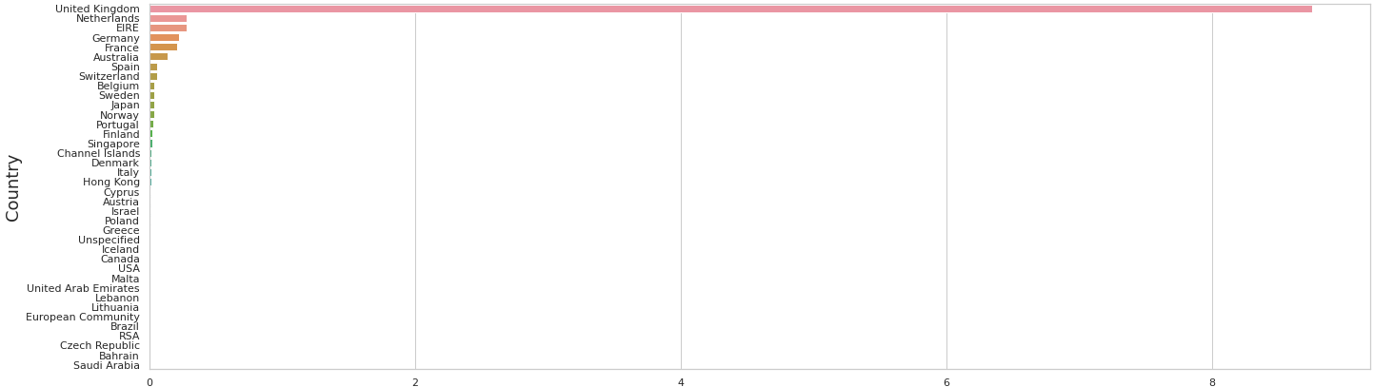
Which country bring most revenue in total and average

Slide 8
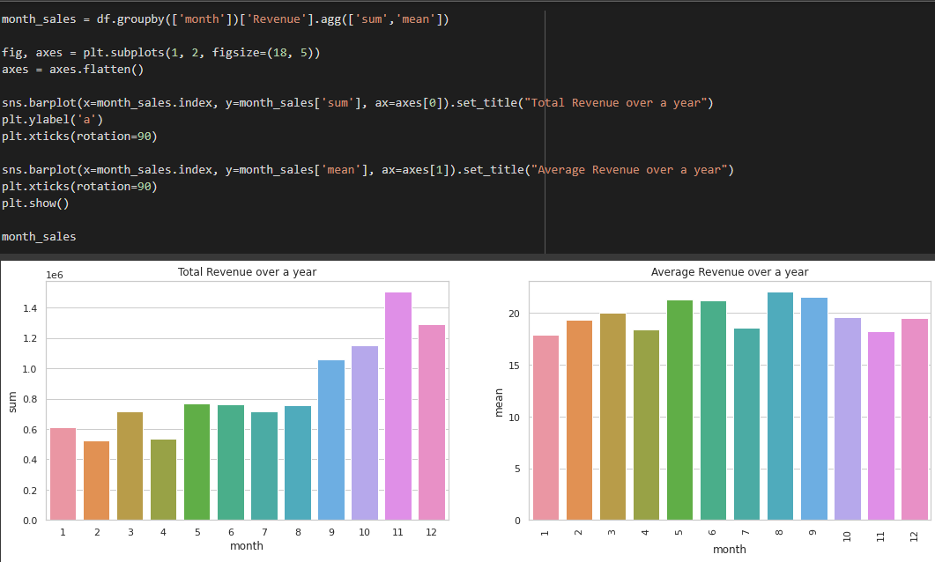
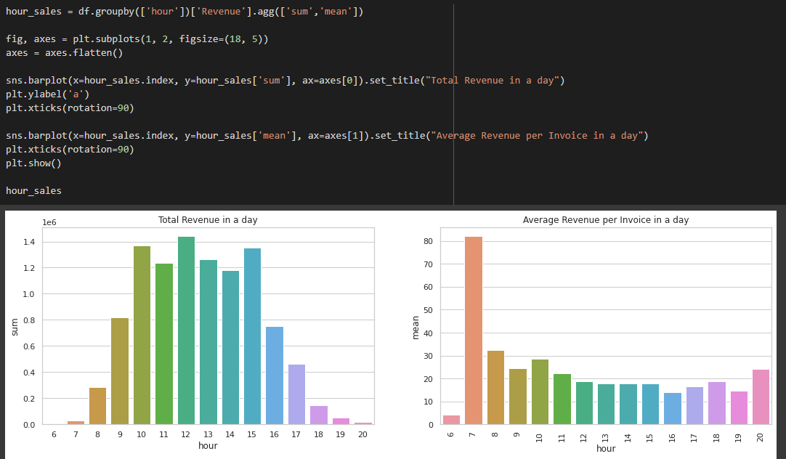
Which month we sell out most and least
What time do people tend to buy our products

Slide 9
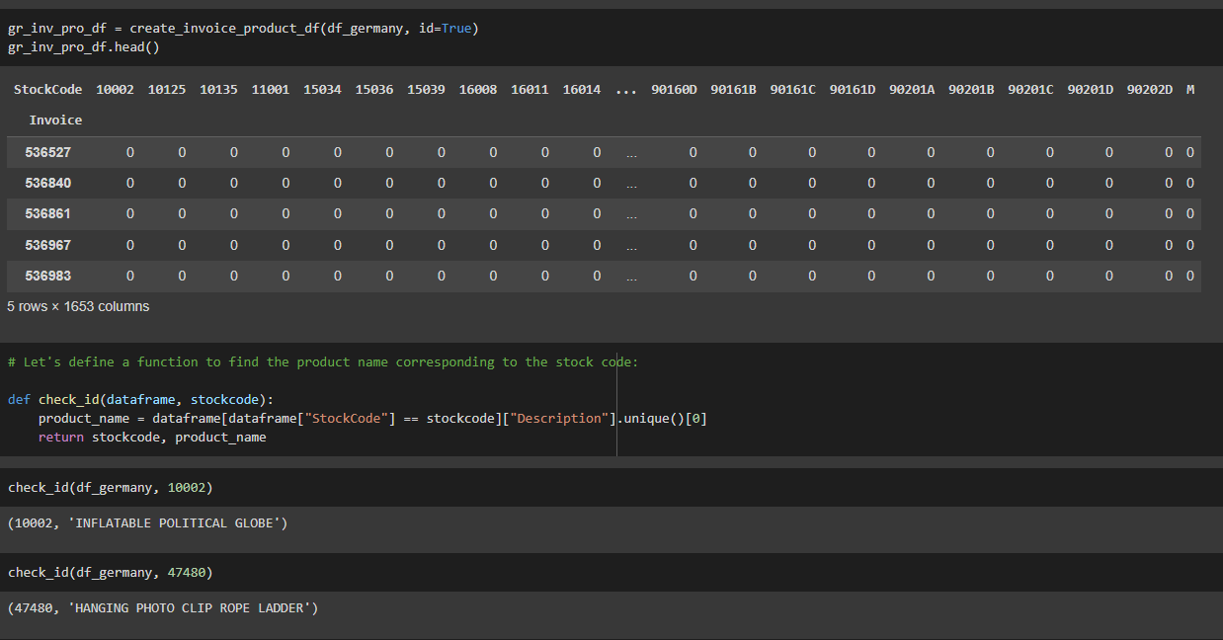
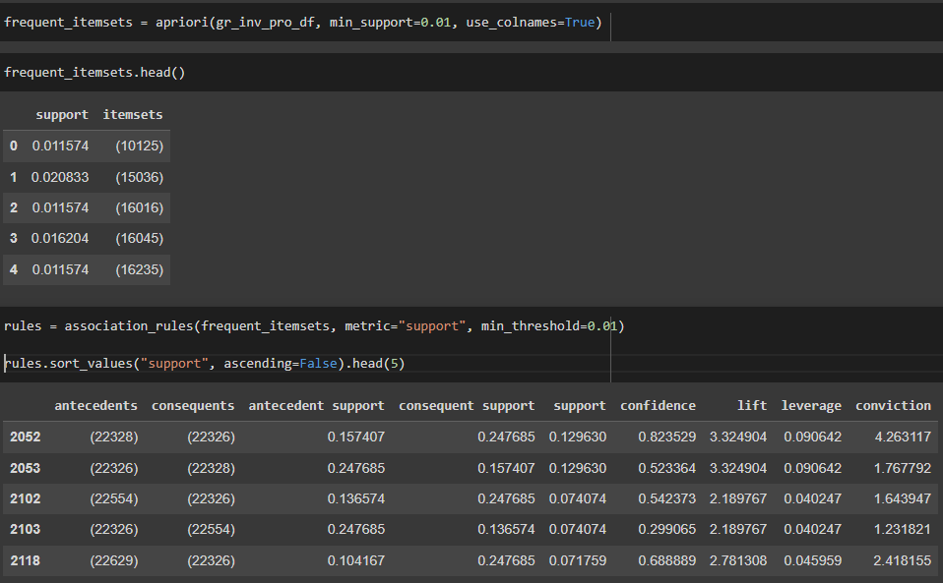
Preparing Invoice-Product Matrix for ARL Data Structure
Determination of Association Rules

Slide 10
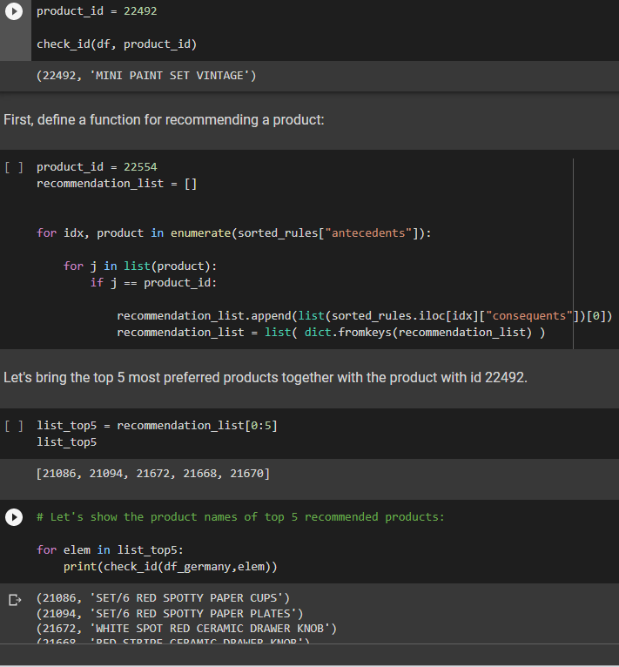
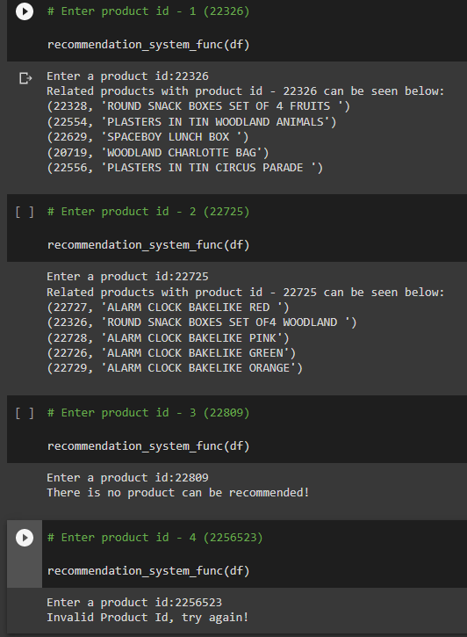
Suggesting a Product to Users at the Basket Stage

Slide 11
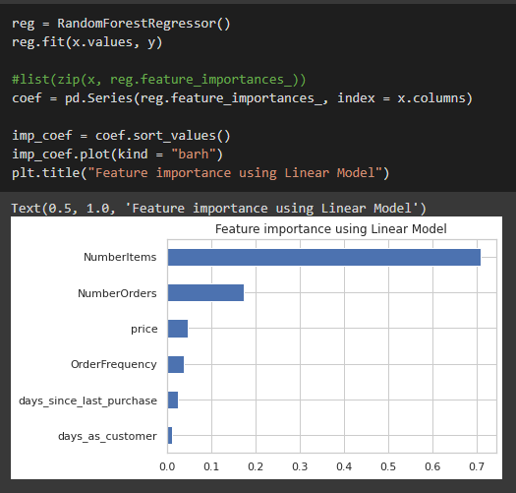
MODELING
The diagram below indicates NumberOrders and UnitPrice are 2 most important factors of forming revenue.
As we already discuss above, having higher price may have traded off against Number Orders, thus the next step for the company is to run the A/B Test to know if we should increase UnitPrice followed by a deduction of NumberOrder and vice versa.

Slide 12
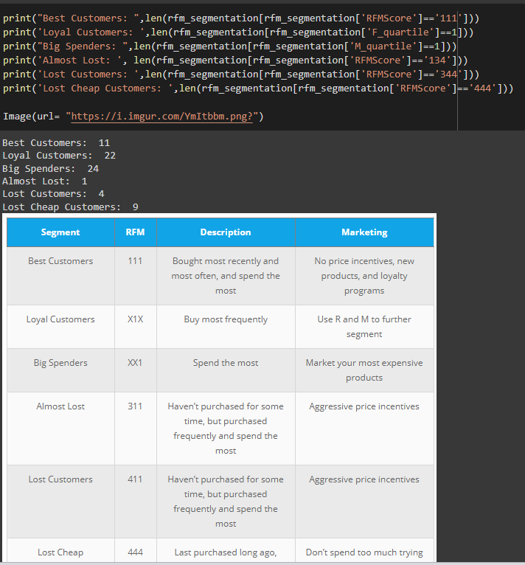
RFM - Recency Frequency Monetary
By RFM score we can find the how many best customer ,loyal customer, big spenders customer, lost customer, almost lost customer ,lost cheap customer

Slide 13
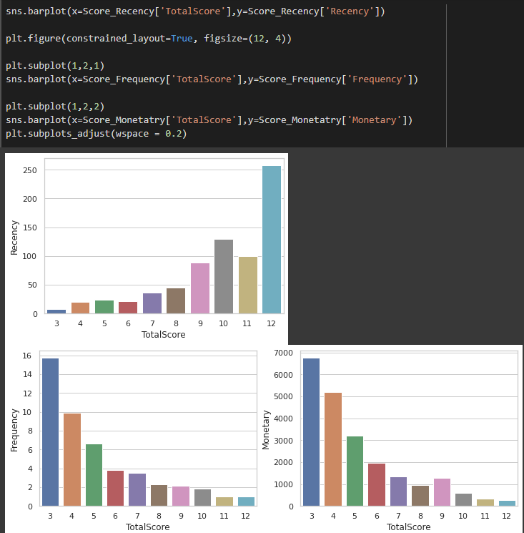
Now we are finding the total score with the RFM value
Based on Recency, categories 10,11,12 have highest value which is good for model. because it could have combination of values such as 444, 434, 334 etc.
Based on Frequency, categories 3,4,5 have highest value which is good for model. because it could have combination of values such as 111, 121, 122 etc.
Based on Monetary, categories 3,4,5 have highest value which is good for model. because it could have combination of values such as 111, 121, 122 etc.

Slide 14
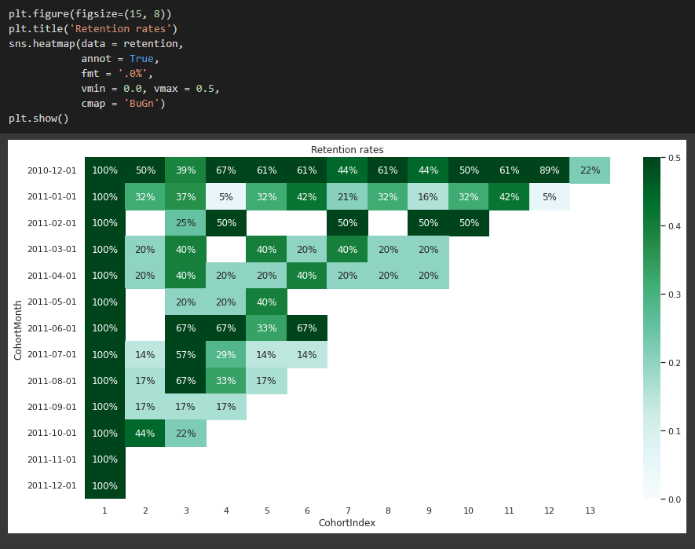
COHORT ANALYSIS
A cohort is a group of users who share a common characteristic. For example, all users with the same Acquisition Date belong to the same cohort.
The retention rate show the percentage of customers return in the following months after the their first purchase.
Customer acquisition cost is so expensive that we have to do remarketing our clients to retain them. If The retention rate is low, it means we have to spend more budget amount to acquire more customers to visit.

Slide 15

Web page
First ,we have to enter the customer ID

Slide 16
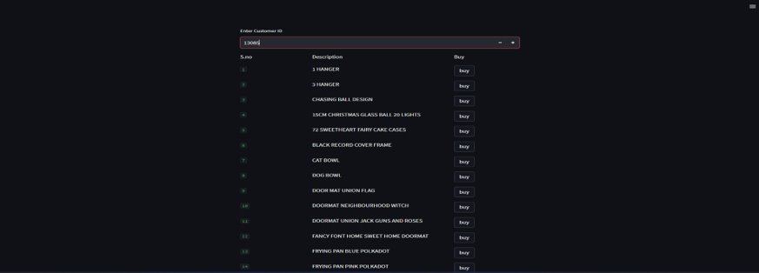
After that it will be showing product which are the product bought by the customer on that ID

Slide 17
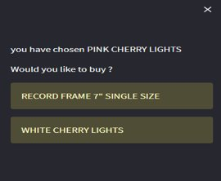
After selecting the antecedents product we can get the consequents product
With the help of support metric lift we get these two product because it has more 1 as value .so we can say it as good association in business analysis

Slide 18
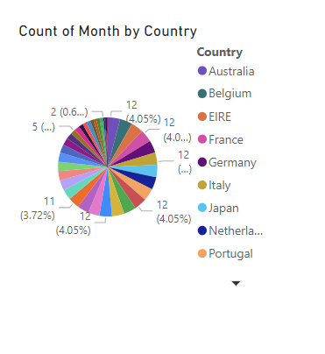
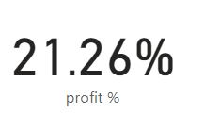
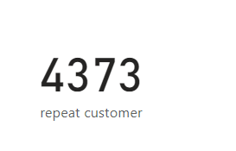
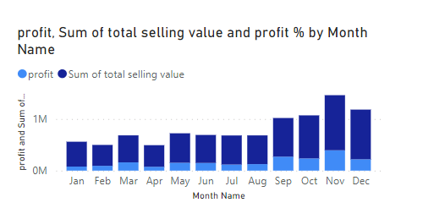
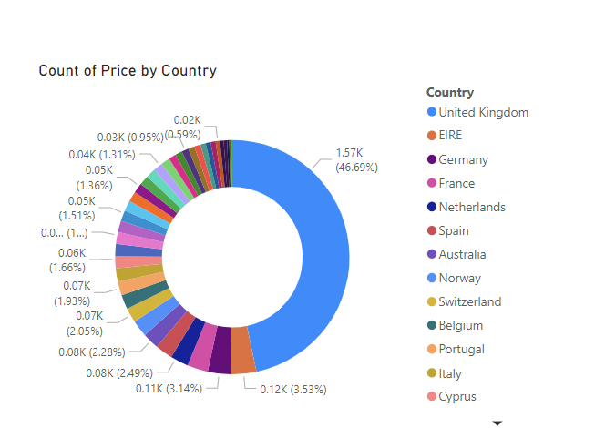
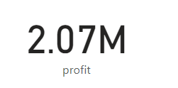
Data visualization

